Slide 1
T-02

Slide 2
Agenda
Project Motivation and Need
Our approach
Prior work
Our design and implantation
Results, Contributions and Lessons Learned
Q/A
Demo

Slide 3
Prior Work
Adafruit
Main project idea
No code
Ideas for circuits
Bob Pease
Solenoid snubber circuit
Various Youtube Videos
Working with AVR
Timers, ADC, Interrupts, etc.

Slide 4
System Design

Slide 5
Hardware Level 0/Level 1

Slide 6
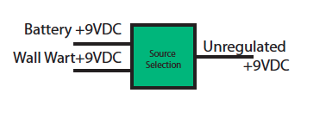
Power source select
Instant Backup
Option for charging
Decided to opt out of battery charging
Lower parts count
Lower total cost
Decided it would be unnecessary

Slide 7
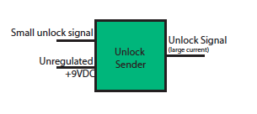
Unlock Sender
Depends on lock
Deliver large current
to solenoid.
Various driver options
Relay
Darlington Pair
Mosfet

Slide 8
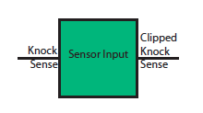
Sensor input
Protect the microcontroller
Transients on the line
Overvoltage

Slide 9
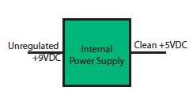
Internal power supply
Produce a clean
voltage supply.
IC regulators
Low cost as possible

Slide 10
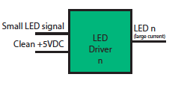
LED Driver
General purpose
switching.
LED types
Individual LEDs
Common Anode

Slide 11
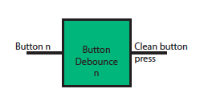
Button Debounce
Remove button bounce
Could have been S/W
Decided to include hardware debounce functionality.

Slide 12
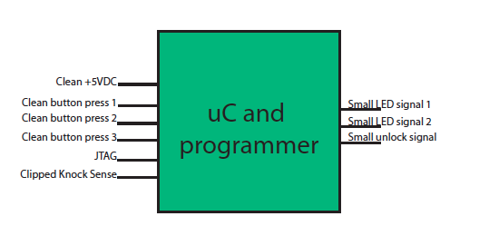
microcontroller
Central Module
Various choices
Cost
Simplicity
Availability
Decided lowest cost as primary concern

Slide 13
Implementation

Slide 14
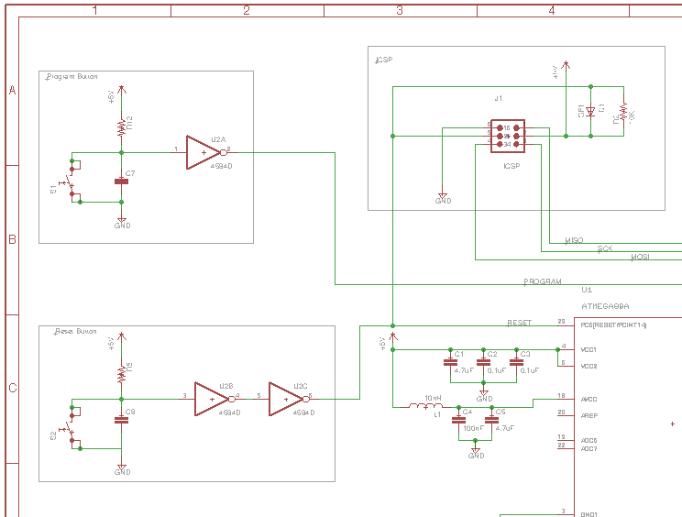
Implementation
We began the circuit design after creating system requirements and figuring out what type of functionality is required from the hardware.
Specified sub-circuits in the system and designed each in a modular fashion.
Obstacles that where overcome, in this stage of the project include (eagle learning curve, Github crashes and general circuit troubleshooting).

Slide 15
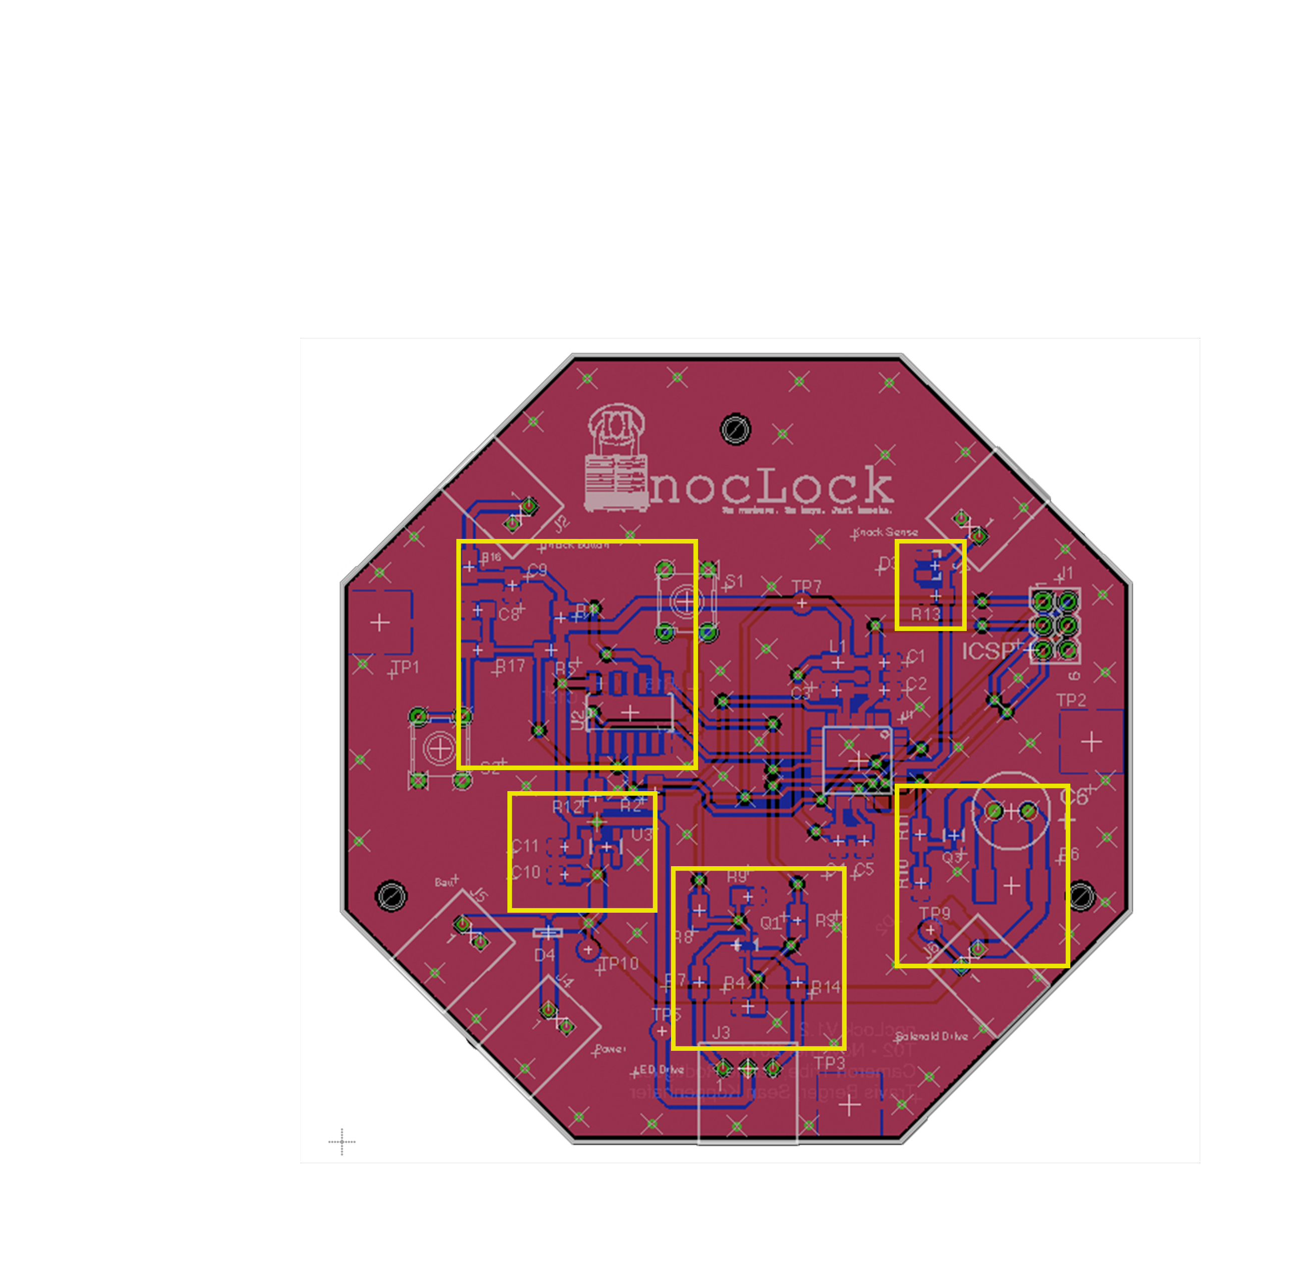
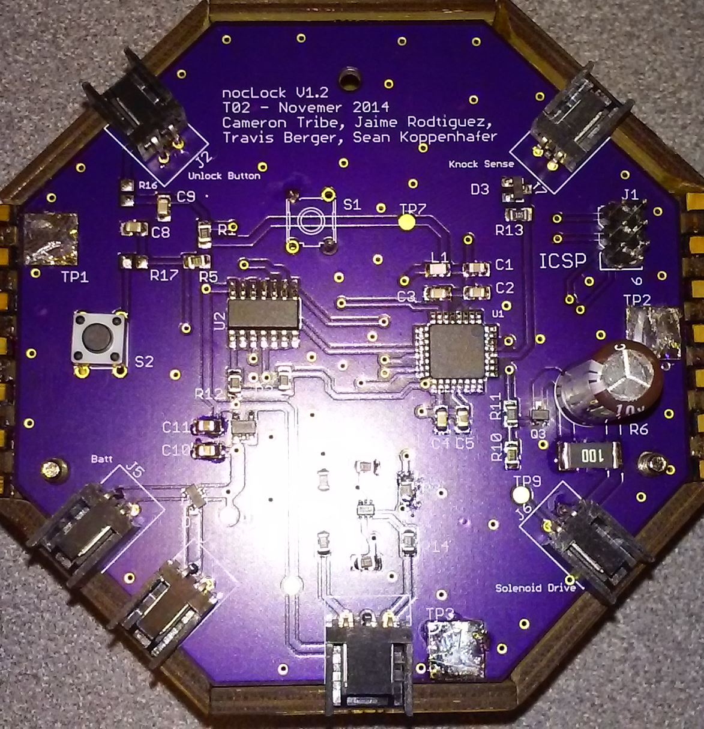
Board Layout
Because this project is more of a novelty than a serious product we wanted to show off and be creative every chance we got, this is just one example.
Button
Inputs
Sensor
input
Power
Supply
Solenoid
LED’s

Slide 16
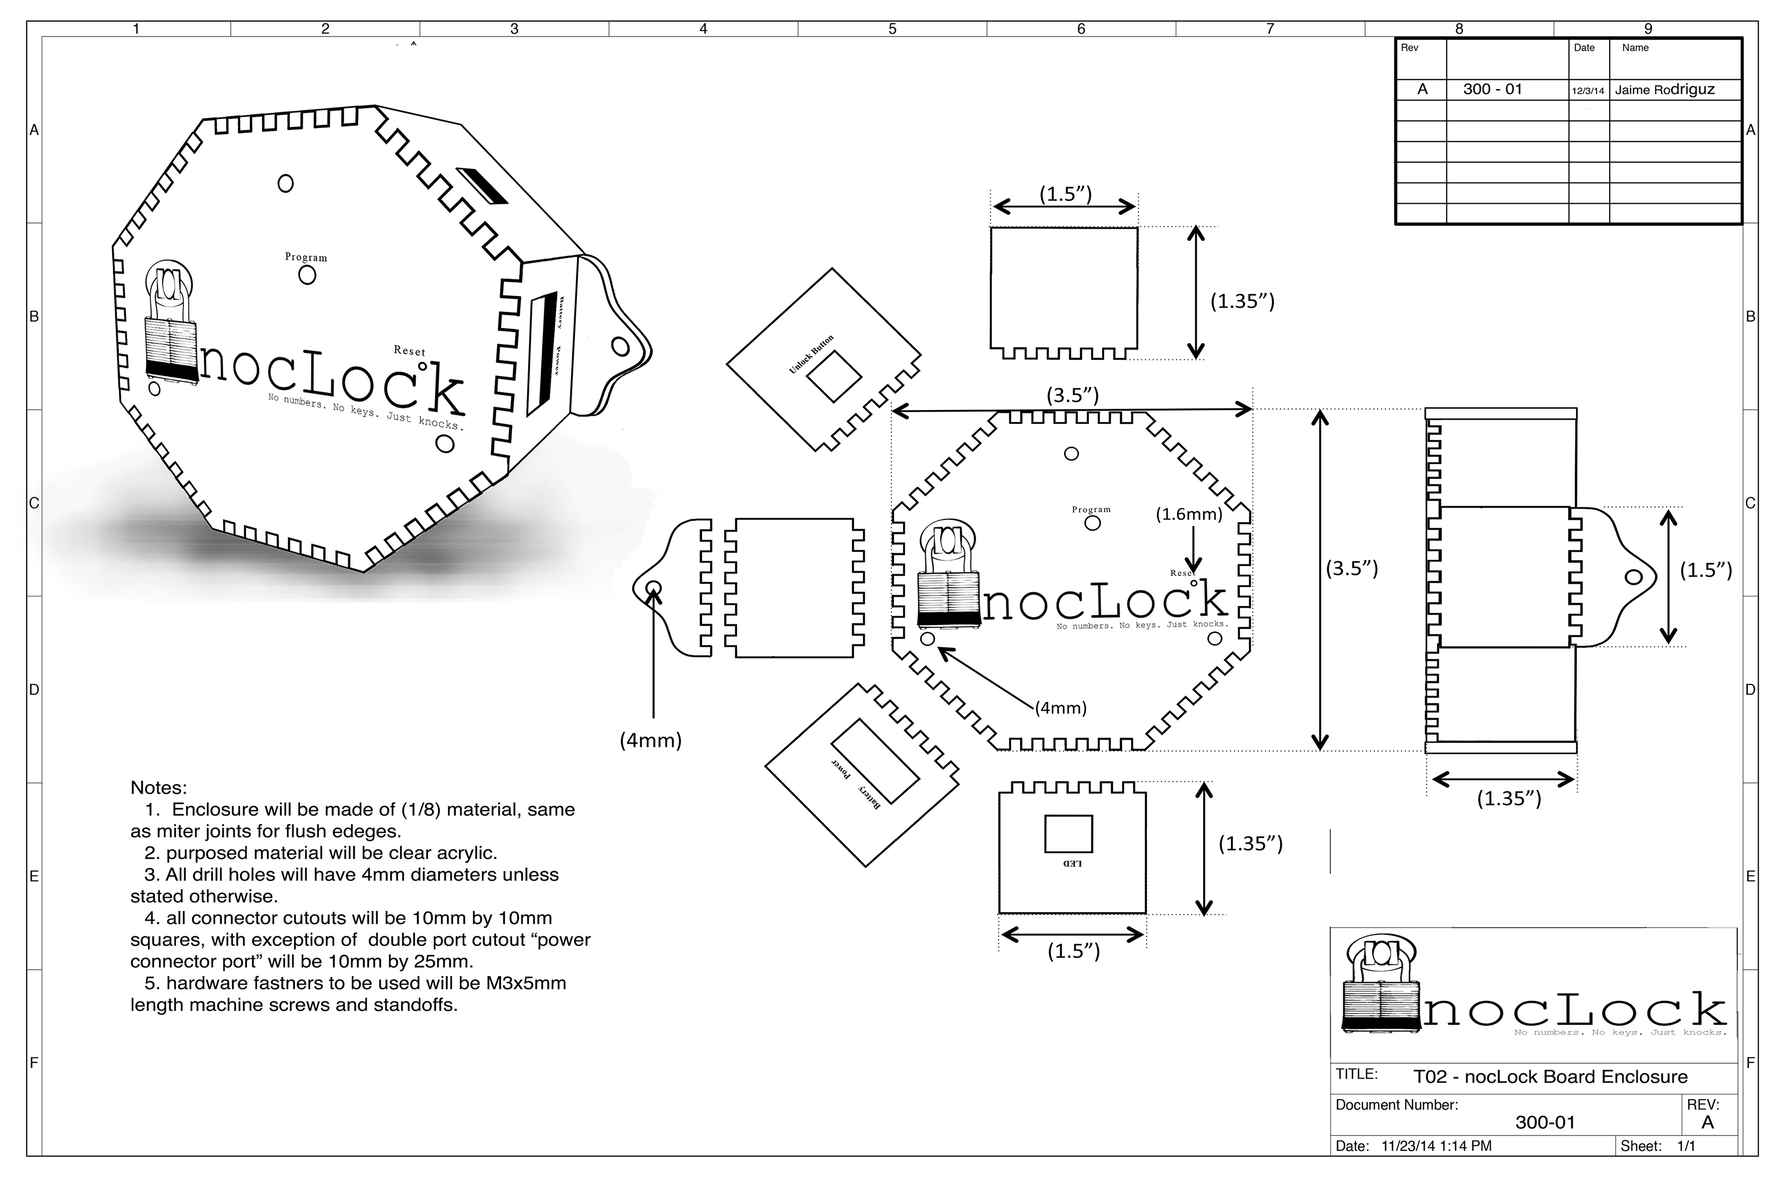
Board Enclosure

Slide 17
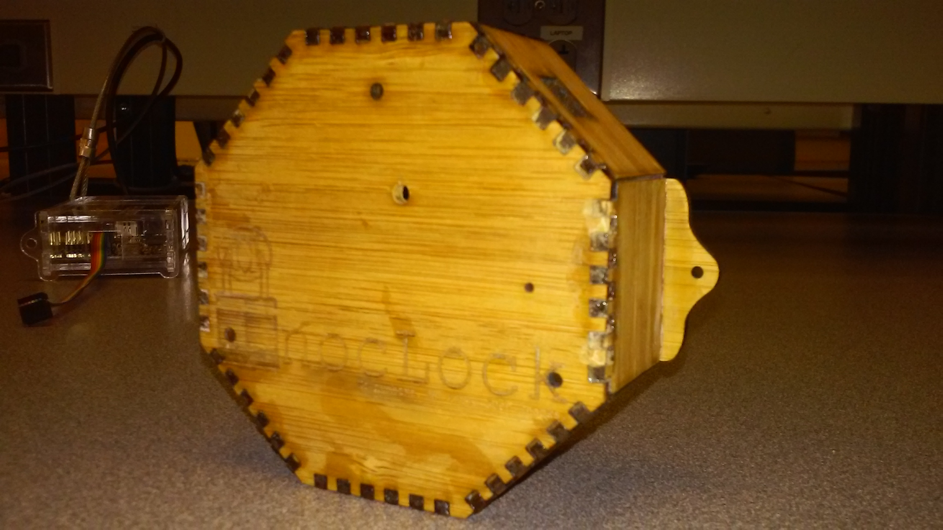

Slide 18
contributions
Cameron
Travis
Sean
Jaime

Slide 19
Results
Things that worked on the board:
Solenoid Driver circuit
Power Supply
LED Driver
Things that worked in our group:
Communication
Work balance
Flexibility

Slide 20
Results
Things that DIDN’T work on the board
Buttons
Software for buttons
Program button
ICSP
Things that DIDN’T work in our group
Github for schematics
Working too soon
Communication
Not enough work

Slide 21
Lessons - Cameron
Eagle CAD
Library management
PCB Layout
Schematic Drawing
Simple CAD drawings
EPL equipment
Microcontroller interfacing
Project management

